Slide 1

Frontline
Absence Management
Time & Attendance

Slide 2

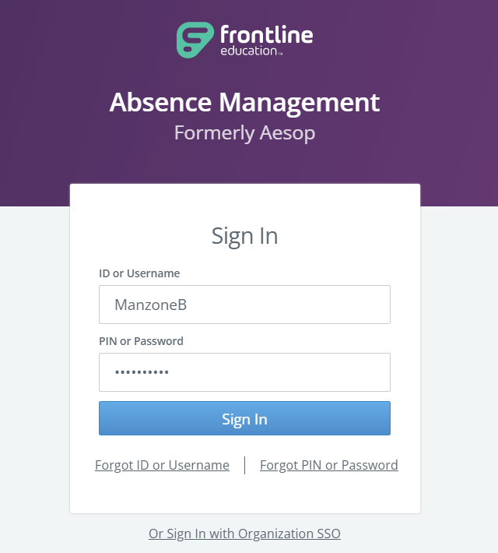
Frontline (Aesop)- Absence Management
XXXXXX
*Example only- some features and leave types may vary.

Slide 3
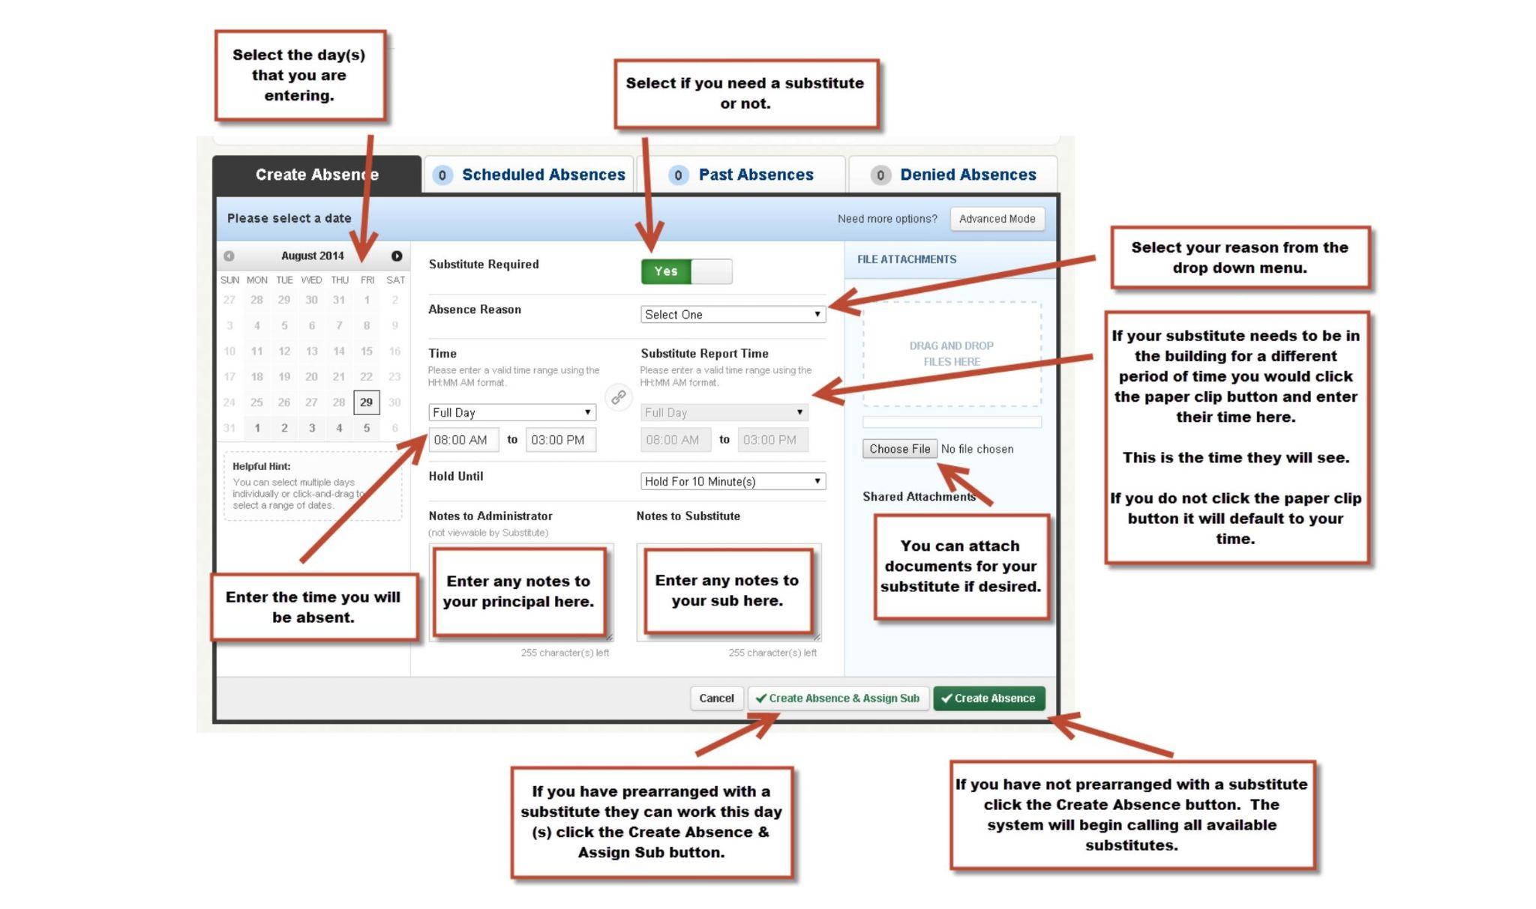

Slide 4
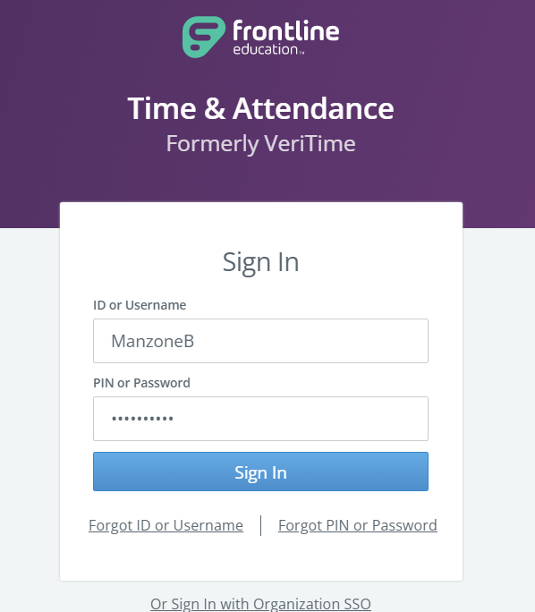
Frontline (VeriTime)- Time & Attendance
Salary Employees- Will only need to review/submit or add a timesheet for extra duty hours.
Hourly Employees- Will need to review/submit their timesheet weekly.
  Timesheet will auto populate with your base working hours per contract day.
  Adjust populated time only if you did not meet your base hours that day, comment required.
  If you worked over your base hours:
    Add Timesheet> Select Date> Select “Extra Duty”. Change to “Duration” and enter total additional hours with a comment.
Absences entered in Absence Management will auto populate onto your timesheet.
XXXXXX

Slide 5
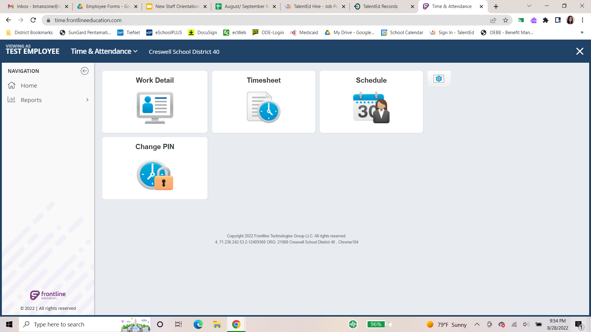
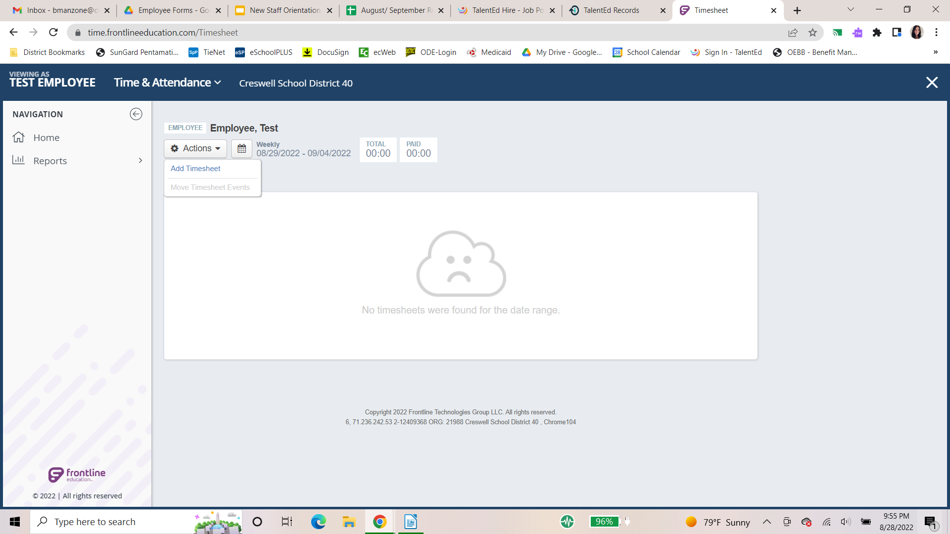
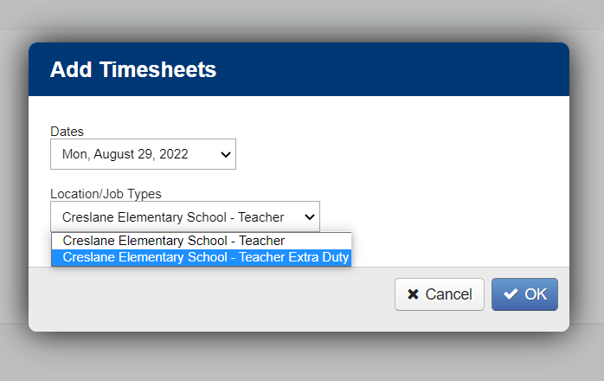
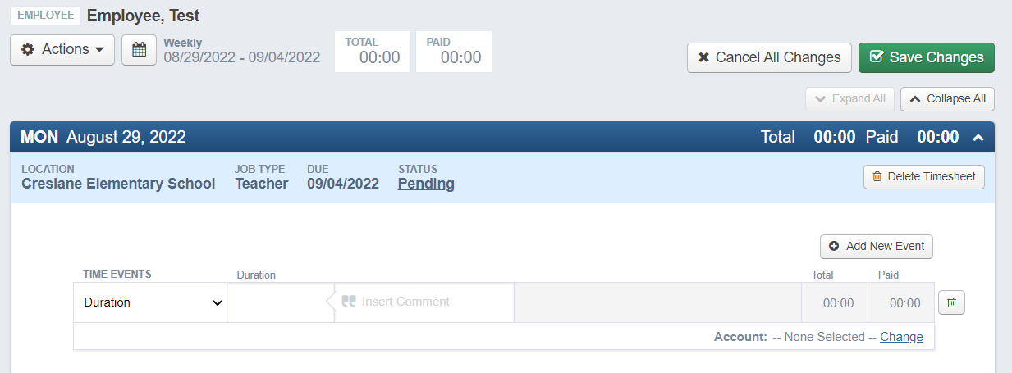
Time & Attendance- Add Timesheet
The system will alert you if a timesheet already exists for the selected job type/date.
Always select “Duration”, enter total hours and enter comment. Save Changes.

Slide 6
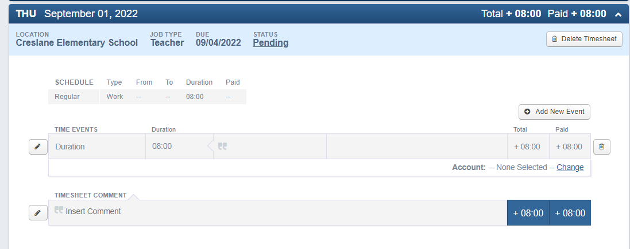
Time & Attendance- Change Base Hours
Select the date you need to edit. (If date has already been submitted you will need to “Undo Submission” first.)
Click the pencil edit button
Change the duration down to the hours you actually worked
Insert Comment *Required
Save Changes

