Slide 1
23-24 Integrated Programs
Annual Report Presentation

Slide 2
Annual Reporting Requirements
ODE’s annual report consists of two narrative questions
Throughout the year, grant recipients have been asked to report expenditures, three overall reflection narrative questions, and report on progress markers which will help inform overall progress and annual report.

Slide 3
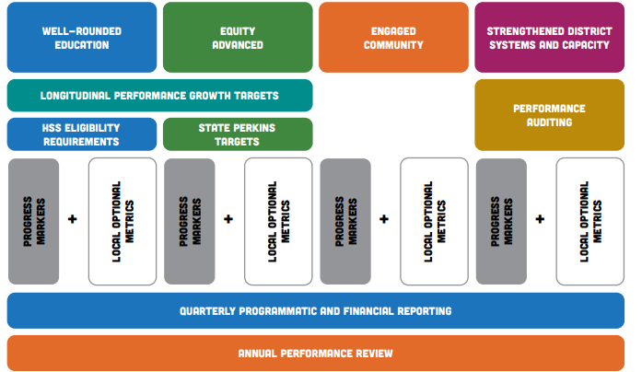
Summary of Integrated Programs Performance Measures
Notes:
There are seven distinct performance measures and processes used in the monitoring and evaluation process for implementation under this integrated guidance:
1. Longitudinal Performance Growth Targets (LPGTs)
2. High School Success Eligibility Requirements
3. State CTE Perkins Performance Targets
4. Progress Markers
5. Local Optional Metrics
6. Quarterly and Financial Reporting
7. Annual Reporting 8. Auditing (SIA funds only)
9. Performance Reviews
Here’s one way to visualize how these evaluation components fit together:

Slide 4
SIA Annual Report Requirements
SIA recipients are required by statute to:
review their own progress on an annual basis through an annual progress report and financial audit
present their annual report to their governing board at an open meeting with opportunity for public comment (cannot be consent agenda item),
and post the report to the district or charter school website.
If grantee set LPGTs and LOM:
In Year 1 of biennium: Affirm progress has been reviewed towards meeting the LPGTs in the grant agreement (Assurance)
In Year 2 of biennium: Review actual metric rates compared to previously created LPGT and LOM and share reflection on progress. (Narrative Question)
Notes:
[Only use this slide if you are receiving SIA Funds]

Slide 5
Annual Report Narrative #1
As you review your progress markers/overall reflection responses and reflect on plan implementation, how do you see your progress contributing to the Outcomes and Strategies in your plan and your Longitudinal Performance Growth Targets (LPGT)/Local Optional Metrics (LOM)?
Discuss at least one Outcome where you have seen progress in implementation.
Over the past year, Creswell School District has made measurable progress in several key Outcomes within our educational plan, each aligning with our overarching goal to support student success and meet our Longitudinal Performance Growth Targets (LPGT) and Local Optional Metrics (LOM).
Outcome A focuses on developing K-12 pathways for life, college, and career readiness. We've advanced this goal through our partnership with leadership expert Mindy Lockard, offering students essential leadership training that builds foundational skills for future academic and professional success.
Outcome B addresses fostering a sense of belonging for all students, with ParentSquare communication, the provision of 1:1 Chromebooks, and actively gathering student perspectives through site council. These tools and initiatives are designed to increase inclusivity and empower student voices, contributing to a supportive school culture.
For Outcome C, which centers on long-term student wellness, we’ve emphasized healthier meal options with our shift toward scratch cooking. This approach promotes physical wellness and aligns with our commitment to holistic student support.
Finally, Outcome D is focused on instructional support and success. We’ve adopted new Math and Language Arts curricula, paired with comprehensive literacy strategies and professional development, ensuring that our educators are equipped to deliver high-quality instruction that meets diverse student needs.
Collectively, these steps demonstrate a strong alignment with our Outcomes, advancing our goals for student success and well-being across all grade levels.

Slide 6
Annual Report Narrative #2
Where have you experienced barriers, challenges, or impediments to progress toward your Outcomes and Strategies in your plan that you could use support with?
Discuss at least one Outcome where you have seen challenges or barriers to implementation.
A significant barrier to progress toward our Outcomes and Strategies has been student attendance. Across multiple grade levels, low attendance rates have created challenges in maintaining continuity of instruction, reducing engagement, and impeding students' ability to meet the academic and social-emotional growth targets outlined in our outcomes.
Challenges and Impact on Outcomes:
- Inconsistent Engagement: Lower attendance disrupts students' learning progress, making it difficult to maintain consistent engagement and achieve intended academic growth. When attendance gaps occur, students face learning setbacks that require additional instructional time and resources to help them catch up, impacting overall progress.
- Resource Allocation: Addressing attendance issues also requires significant resources, including staff time dedicated to outreach and support for frequently absent students. This diverts resources from direct instruction and enrichment opportunities that could benefit the larger student body.
Support in these areas would help us address these challenges and move closer to achieving our intended outcomes.

Slide 7
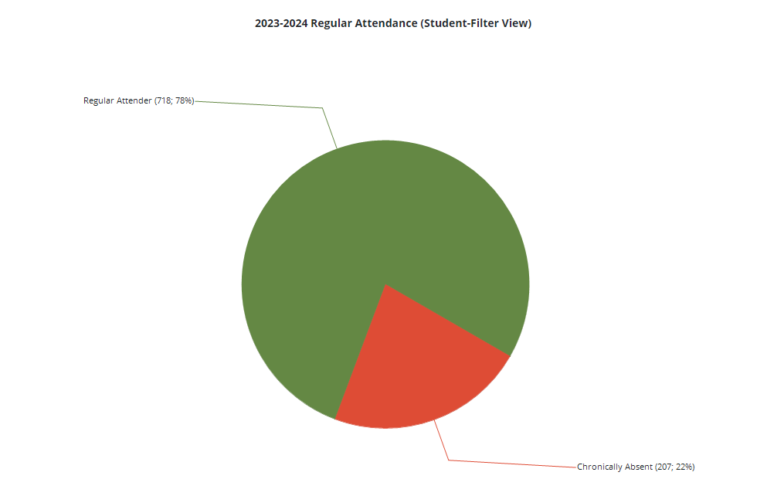
Annual Report Narrative #2

